Slide 1

Performance Management in Azure
“Slow” is the new “Down”
Scott Glasser
Riverbed Technology

Slide 2
Agenda
1
Murphy’s Law still applies in Azure
2
Ya gotta know the terminology
3
Keep track of your roster
4
You can’t hit what you can’t see
5
Averages and samples don’t tell the story

Slide 3
Murphy’s Law still applies in Azure
“What can go wrong, will go wrong” (and may be be going wrong already)
Diagnosing performance problems was never easy
It was hard enough when servers and services stayed put
“Intermittent” = Hard to find the root cause of problems

Slide 4
Ya gotta know the terminology
(if you don’t want to be completely lost at the game)
Term | Activity | Source Data
End User Experience (EUE) | Monitoring and Trending | Web browser, Mobile device, Agent (API)
Network Performance | Monitoring and Troubleshooting | Packets and Traffic Flows (Physical/Virtual Router/Switch/etc.)
Application Performance | Monitoring and Troubleshooting | Code, Methods, Tiers

Slide 5
Cloud Terminology
Infrastructure (as a Service)*
Platform (as a Service)*
Software (as a Service)
On Premise
Applications
Applications
Applications
Applications
Data
Data
Data
Data
Runtime
Runtime
Runtime
Runtime
Middleware
Middleware
Middleware
Middleware
OS
OS
OS
OS
Virtualization
Virtualization
Virtualization
Virtualization
Servers
Servers
Servers
Servers
Storage
Storage
Storage
Storage
Networking
Networking
Networking
Networking
*but what about bare-metal IaaS? Hybrid?
Notes:
IaaS examples: openshift, Amazon S3, softlayer (also provides baremetal)
IaaS: all licenses are included for installed software.
PaaS example: (application containers), heroku, openshift, cloud foundry,
SaaS examples: O365, Salesforce, New Relic

Slide 6
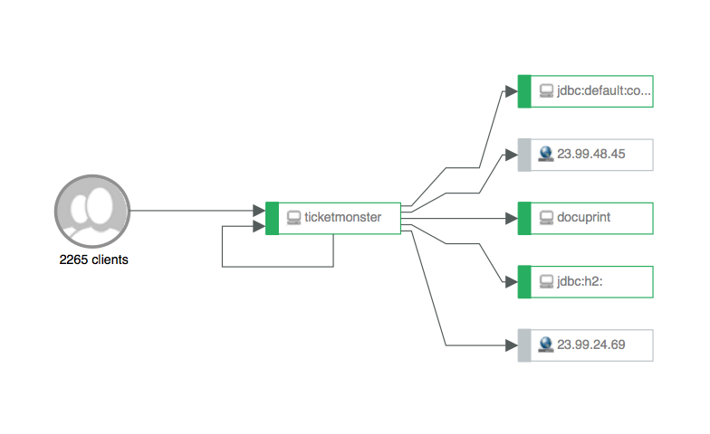
Keep track of your roster
Who’s on the field, available on the bench, and in the bullpen?

Slide 7

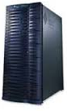




You can’t hit what you can’t see
“He would have been a great hitter, but he couldn’t hit a curve ball”
To find the root cause of application performance problems,
you need to see Application Transactions from End to End
www.criticalbusiness-app.com/home.aspx
EUE
Network
App
App
App
App
End user
WAN 231ms
LAN 11ms
WebTier 9ms
AppTier 7.7sec
DBTier 24sec
Slow end-user experience..
38.9sec end user
experience

Slide 8
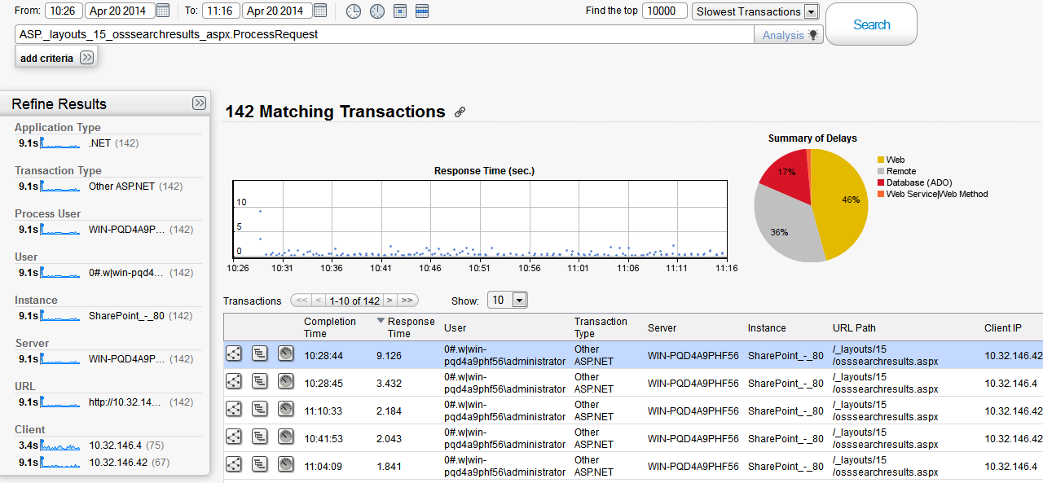
Averages and samples don’t tell the story
“He’s a 400 hitter, but only 250 with runners in scoring position”

Slide 9


Averages and samples don’t tell the story
Performance metrics with 1-second granularity
Diagnosis: Intermittent CPU Saturation
The same data, but measured with 15-second granularity
Peak of 64%
Diagnosis: Everything’s Fine!

Slide 10
Averages and samples don’t tell the story
“This pitcher has a lower ERA with this catcher – or is it really about the pitch count?”
Metric A Reference Metric
Metric B Strong Correlation
Metric C No Correlation
Metric D Weak Correlation

Slide 11
Be an Application Performance Major Leaguer
1
Monitor and Trend End User Experience
2
Understand Application Dependencies (Application Maps)
3
Track & remember all transactions “all” the time (Big Data! Intermittent? No problem!)
4
Focus on the slowest transactions (Outliers matter most!)
5
Find and fix root causes by correlating metrics (Correlation to find Causation)

Slide 12
Going into the post-season
Questions?
Please take a 5-minute survey:
https://www.surveymonkey.com/s/cloudify
For more information:
Scott.Glasser@riverbed.com
Twitter: @scottygch
LinkedIn: scottmglasser
www.riverbed.com

